Slide 1
Natural Language Processing (NLP)
Lecture 7: Language Model Enhancements
Dr. Muhammad Taimoor Khan

Slide 2
Dataset
<s> I am Sam </s> <s> Sam I am </s> <s> I do not like green eggs and beef </s>
Calculate the following using Unigram, Bigram and Trigram
Probability (correctness) of “<s>I do not like Sam</s>”
“<s> I am like ___ “ Predict the next word

Slide 3
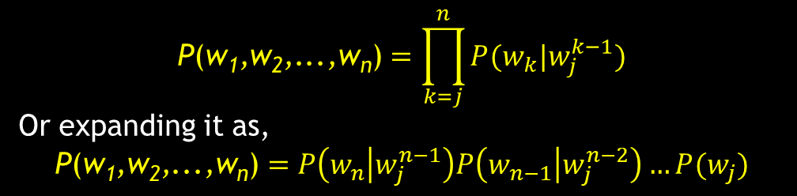
Review (Language Models)
Probabilistic Model
Chain Rule
Markov Assumption
N-grams
Unigrams
Bigrams
Trigrams
…
$$\text{P}\text{(}\text{w}\text{1}\text{,}\text{w}\text{2}\text{,...,}\text{w}\text{n}\text{)}=\prod_{k=j}^{n}{P(w_{k}|w_{j}^{k−1})}$$
Or expanding it as,
$$\text{P}\text{(}\text{w}\text{1}\text{,}\text{w}\text{2}\text{,...,}\text{w}\text{n}\text{)}=P\left(w_{n} | w_{j}^{n−1}\right)P\left(w_{n−1} | w_{j}^{n−2}\right)…P(w_{j})$$

Slide 4
1. Null Probability
Some sequences may be missing the data
It causes zero probability (but their probability may not be zero)
While predicting we usually avoid 0 or 1 probability
WHY!!!

Slide 5

Smoothing
Laplace Smoothing (Add 1 smoothing)
$$P_{Add−1}^{∗}\left(w_{i} | w_{i−1}\right)=\frac{c\left(w_{i−1},w_{i}\right)+1}{c\left(w_{i−1}\right)+V}$$
Add k smoothing
$$P_{Add−k}^{∗}\left(w_{i} | w_{i−1}\right)=\frac{c\left(w_{i−1},w_{i}\right)+k}{c\left(w_{i−1}\right)+kV}$$
Few others to avoid zeros
Discounting
Kneser-Ney
…

Slide 6

2. Underflow
Considering an N-gram Model
$$\text{P}\text{(}\text{w}\text{1}\text{,}\text{w}\text{2}\text{,...,}\text{w}\text{n}\text{)}=P\left(w_{n} | w_{j}^{n−1}\right)P\left(w_{n−1} | w_{j}^{n−2}\right)…P(w_{j})$$
The probabilities are multiplied till the j^{th} word with the value of j depending on the N-gram used
Its usually a long sequence of small probabilities multiplied causing underflow!

Slide 7

Transform to log space
We do everything in log space
Avoids underflow
Addition is faster than multiplication
So,
$$\log\left(p_{1}×p_{2}×p_{3}×p_{4}\right)=logp_{1}+logp_{2}+logp_{3}+logp_{4}$$

Slide 8
3. Disproportionate N-gram Probabilities
Considering any N-gram policy, we are either considering too less or too much context for specific cases
In other words, some words require more context as compared to others
Some words may be two termed e.g., Machine Learning, Artificial Intelligence, language model, battery life, starting time etc.
May have more termed words as well e.g., natural language processing, human computer interaction, peer to peer communication etc.

Slide 9
3. Backoff and Interpolation
Some times it helps to use less context
Condition on less context for contexts you haven’t learned much about
Backoff:
use trigram if you have good evidence,
otherwise bigram, otherwise unigram

Slide 10
Backoff and Interpolation
Interpolation:
mix of unigram, bigram, trigram …
Interpolation works better

Slide 11

Linear Interpolation
Simple interpolation
$$\hat{p}\left(w_{n} | w_{n−1},w_{n−2}\right)=λ_{1}p\left(w_{n} | w_{n−1},w_{n−2}\right)$$
$$+λ_{2}p\left(w_{n} | w_{n−1}\right)$$
$${+λ}_{3}p(w_{n})$$
Such that,
$$\sum_{i}{λ_{i}}=1$$

Slide 12
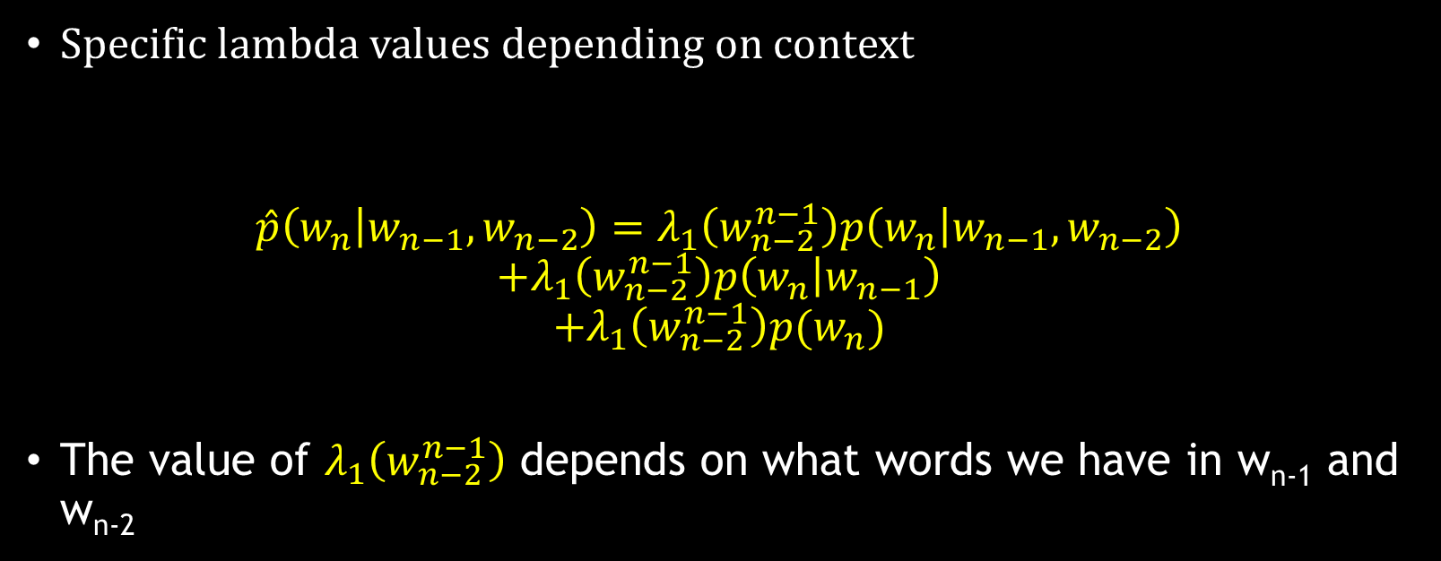
Lambdas Conditional on Context
Specific lambda values depending on context
$$\hat{p}\left(w_{n} | w_{n−1},w_{n−2}\right)=λ_{1}\left(w_{n−2}^{n−1}\right)p\left(w_{n} | w_{n−1},w_{n−2}\right)$$
$$+λ_{1}\left(w_{n−2}^{n−1}\right)p\left(w_{n} | w_{n−1}\right)$$
$${+λ}_{1}\left(w_{n−2}^{n−1}\right)p(w_{n})$$
The value of $λ_{1}\left(w_{n−2}^{n−1}\right)$ depends on what words we have in w_{n-1} and w_{n-2}

Slide 13
4. Unknown Words: Closed Vocabulary Tasks
If we know all the words in advanced
Vocabulary V is fixed
Closed vocabulary task
Often we don’t know this
Out Of Vocabulary = OOV words
Open vocabulary task

Slide 14
Open Vocabulary Tasks
Instead: create an unknown word token <UNK>
Training of <UNK> probabilities
Create a fixed lexicon L of size V
At text normalization phase, any training word not in L changed to <UNK>
Now we train its probabilities like a normal word
At decoding time
If text input: Use UNK probabilities for any word not in training

Slide 15
Huge Web-scale N-grams
How to deal with, e.g., Google N-gram corpus
Pruning
Only store N-grams with count > threshold
Remove singletons of higher order n-grams
Entropy based pruning (Helpful in prediction)

Slide 16
Efficiency
Efficient data structures like trees
Store words as indexes, not strings
Use Huffman coding to fit large numbers of words into two bytes
Bloom filters: approximate language models

Slide 17
Language Model Applications
Has uses in many NLP tasks
Generating text
P(. | Machine) = Learning
Speech recognition
P(I saw a van) >> P(eyes awe of an)
Machine translation
P(High winds tonight) > P(Large winds tonight)

Slide 18
Spell correction
The office is about 10 minuets from my office
P(about 10 minutes from) > P(about 10 minuets from)
Parts of speech tagging
Parsing
Information retrieval
Summarizations
Question Answering …

